Slide 1
Pivot
It’s time for a new hypothesis
Michael Hilton
Assistant Professor
Carnegie Mellon University

Slide 2
Administrivia
Midterm returned today
Extra credit and new Home work released today
Upcoming schedule:
Thursday: Pivot Continued
Tuesday: Guest Lecture (Pivot and Business)
Next topic: Scaling
Upcoming: Final Project
Notes:
https://cmu-17-356.github.io/

Slide 3
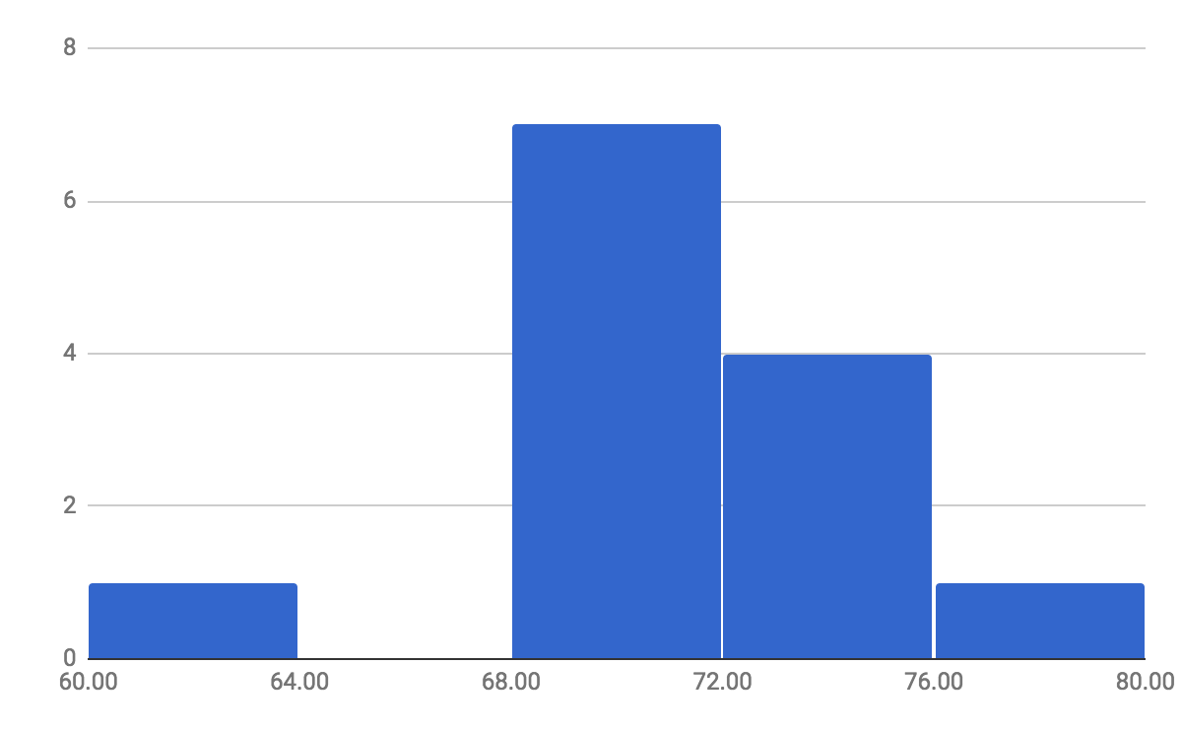
Midterm score distribution

Slide 4
Review
-We have a hypothesis we are trying to evaluate.
-We build an MVP.
-We get feedback from our users.
-What do we do if we find that our hypothesis is wrong?

Slide 5
Pivot

Slide 6
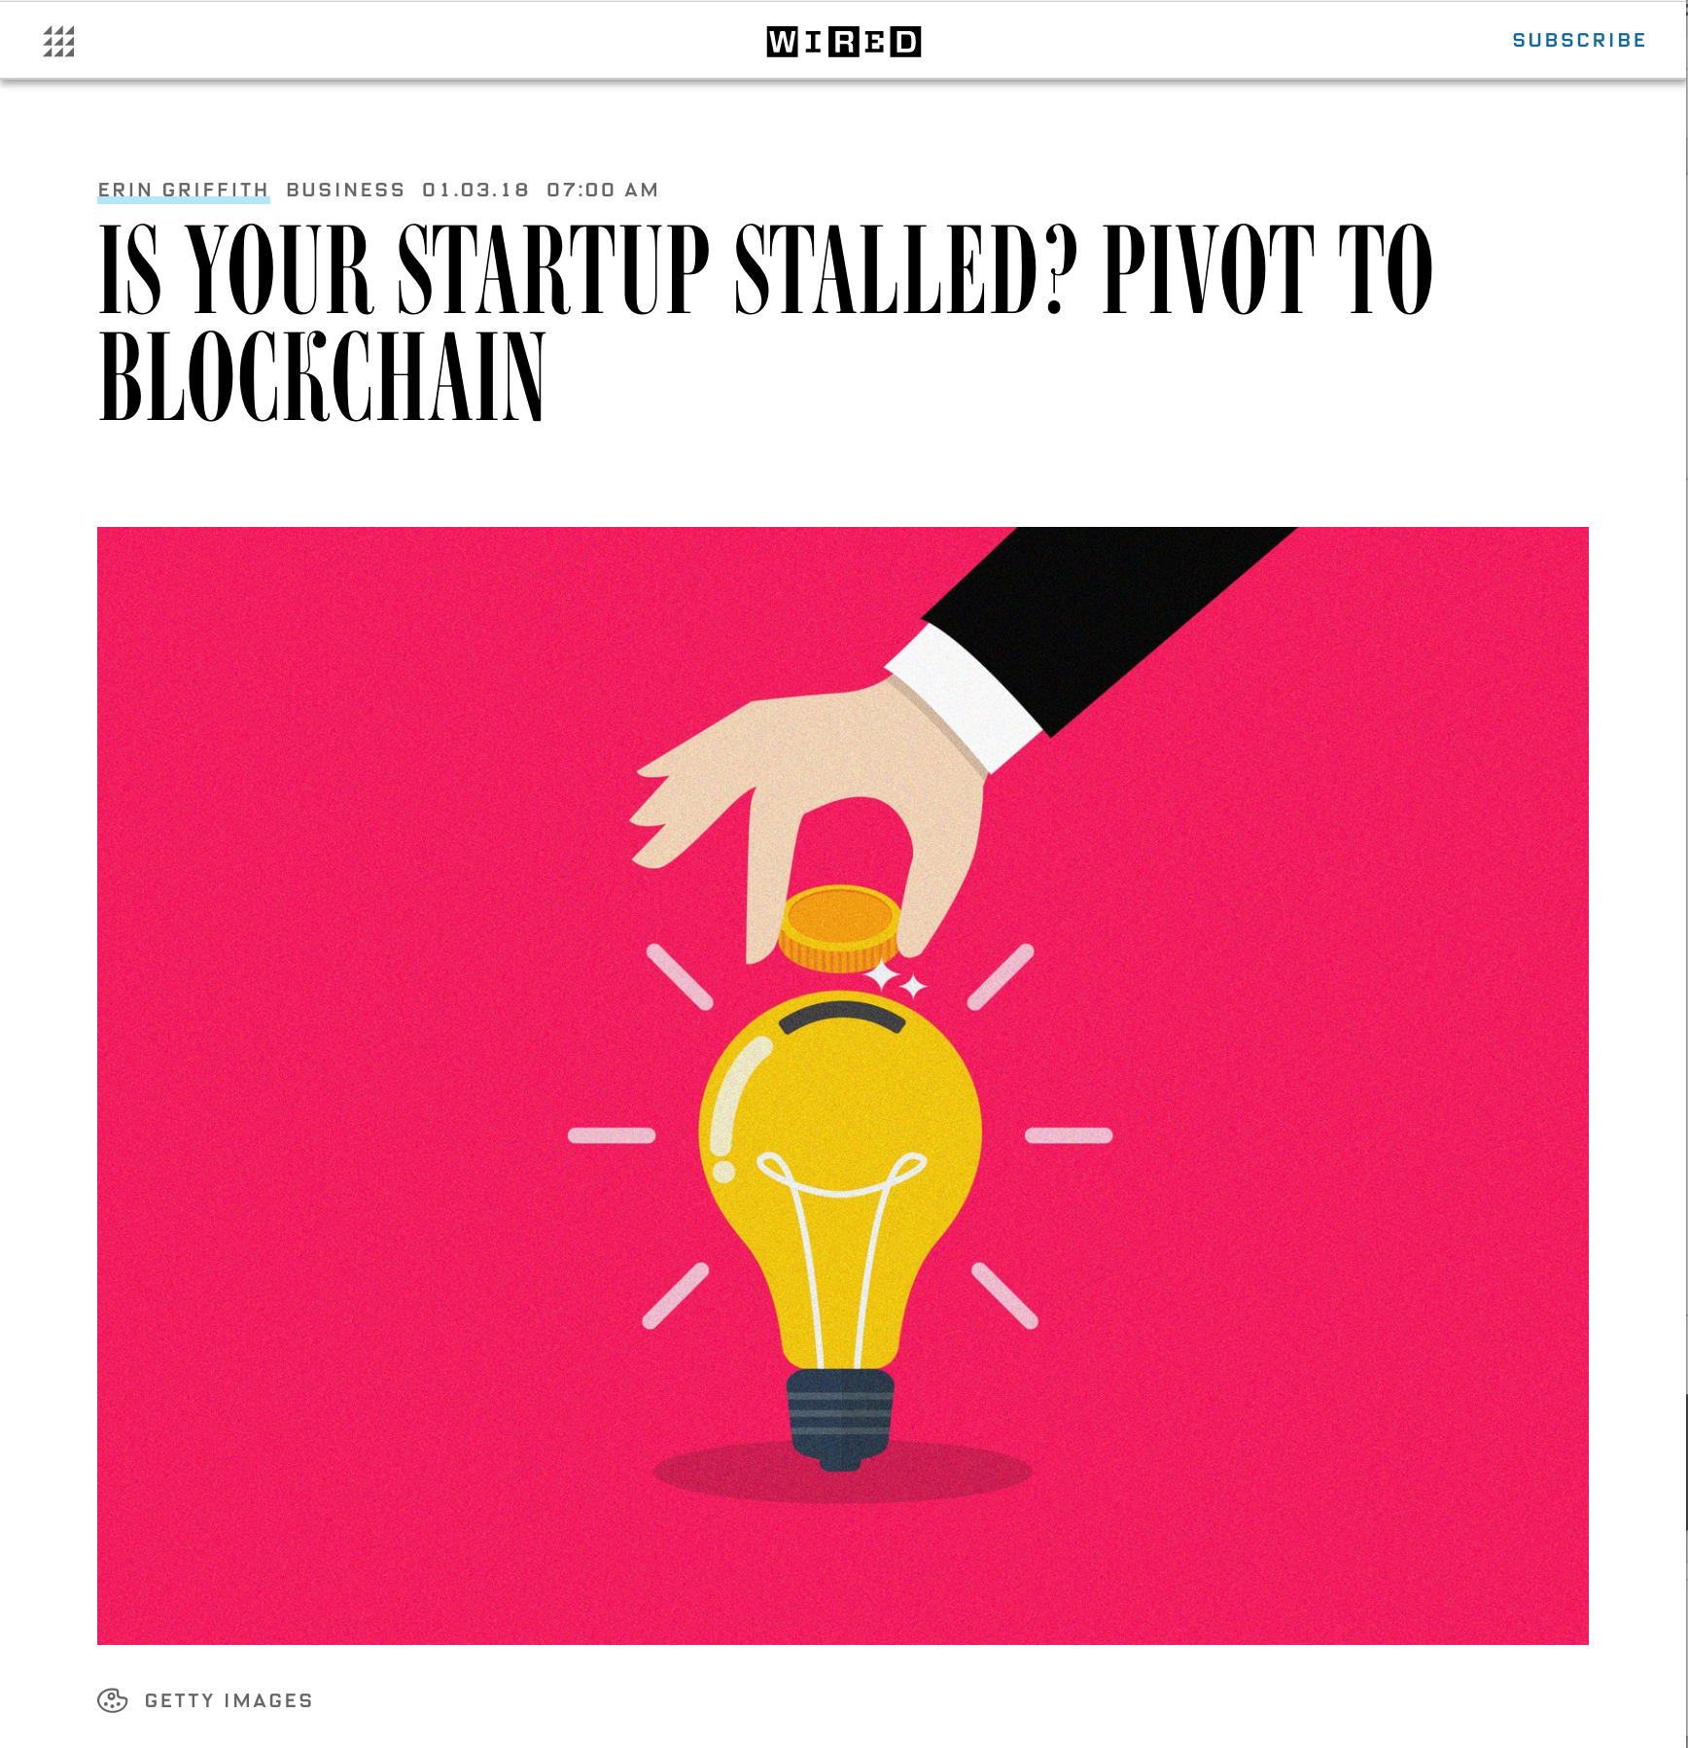

Slide 7


Slide 8
Pivot:
A pivot is a "structured course correction designed to test a new fundamental hypothesis about the product, strategy, and engine of growth."
-Eric Ries, the Lean Startup

Slide 9
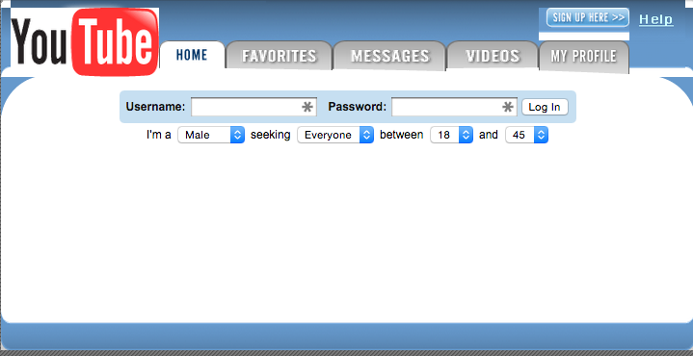
Example Pivots
Source: https://www.washingtonpost.com/news/innovations/wp/2015/07/02/the-7-greatest-pivots-in-tech-history/?utm_term=.473be912ed53
Notes:
offered women $20 each to upload videos of themselves to the fledgling site.

Slide 10
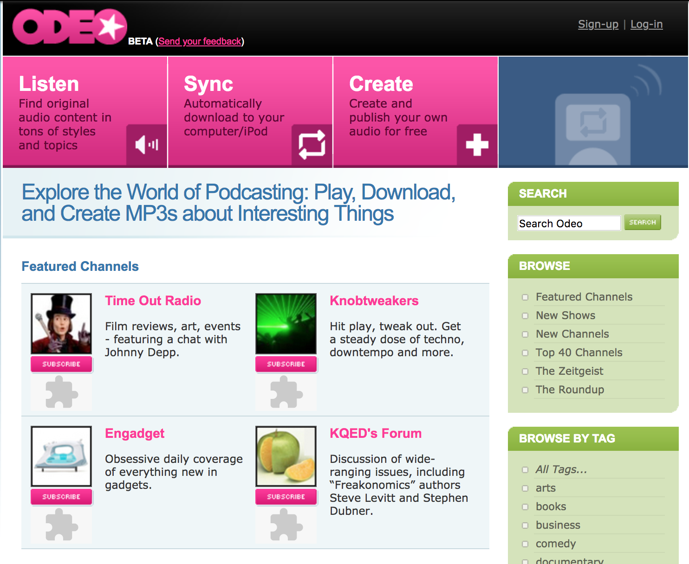
Odeo

Slide 11
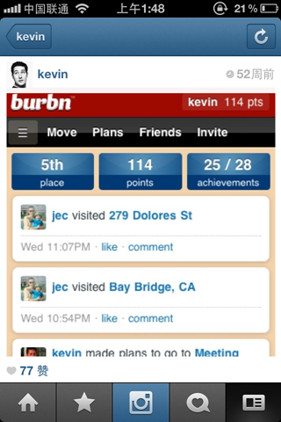
burbn
https://techcrunch.com/2010/09/20/instagram/

Slide 12
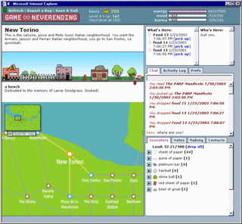
Game Neverending
Notes:
Stewart butterfield: SLACK
Game Neverending was an atypical roleplaying game primarily based on social interaction and object manipulation. GNE was lighthearted and humorous; indeed there was no way to win, nor even any definition of success.^{[2]} Many objects could be combined to create other objects, but any given object only served a questionable amount of purpose. A sense of community and communication between players was encouraged through gamewide and location-specific chat channels, as well as the ability to leave notes for other players at any location.^{[3]} Another aspect of GNE's novelty was that it was being developed into a highly user-extensible game: players were intended to be able to invent new objects and create new locations.^{[2]} The official in-game currency was shekels, but sheets (and quires and reams) of differently colored papers also served as a de facto currency.^{[4]}
The earliest prototype went live on the Internet in the fall of 2002 with the goal of experimenting with real time in-browser interaction, evaluating usage patterns and technical requirements and seeing how players would respond to the "tone" of the game.^{[2]} This was closed February 3, 2003 and eventually a new version was released as a closed beta.^{[citation needed]}
Although development of the game was later shutdown in 2004, the tools built for GNE later evolved into Flickr, a widely-hailed photo-sharing service.^{[5]} Occasional signs of this legacy are visible, such as the '.gne' file extension appearing in Flickr's URLs.[

Slide 13
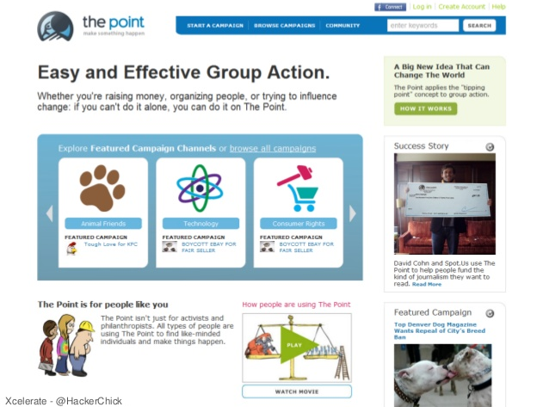
The Point

Slide 14
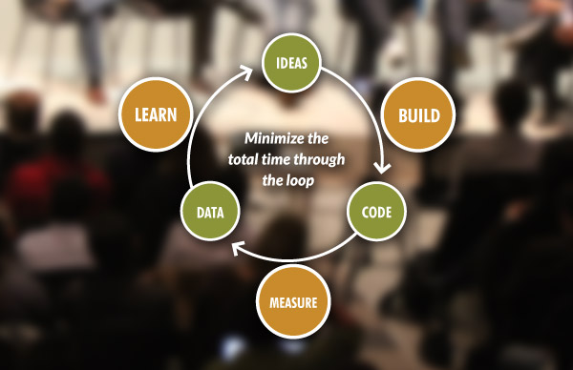
Why do we need to pivot?

Slide 15
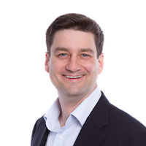

Pivot Case Study
David Binetti
Helped build USA.gov, first portal for the federal government
Case Study from presentation by David Binetti: https://www.slideshare.net/dbinetti/lean-startup-at-sxsw-votizen-pivot-case-study?from_action=save

Slide 16

Votizen Case Study

Slide 17

When and How to Pivot
Presented at Startup Lessons Learned
23 May 2011
David Binetti @dbinetti

Slide 18
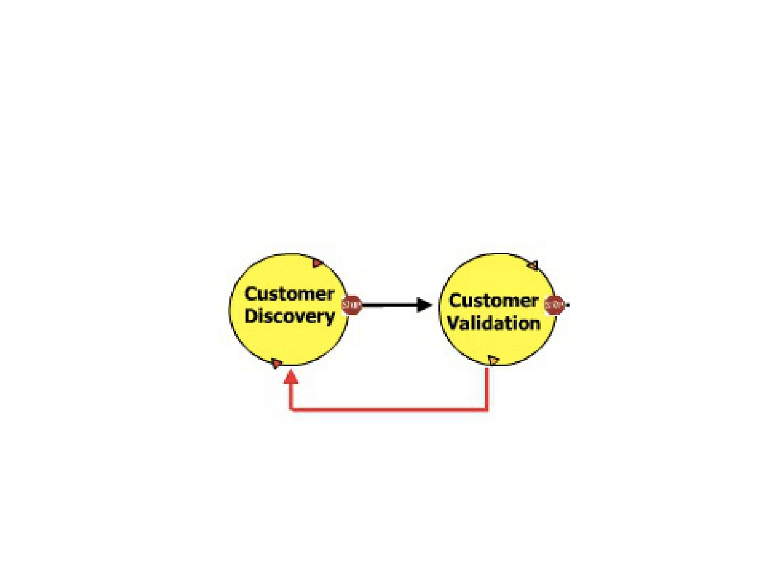
Lean Framework
Formulate
Iterate, Release &
Model
Measure
Pivot
@dbinetti

Slide 19
Lean Framework
Formulate Iterate, Release &
Model
Measure
Pivot
@dbinetti

Slide 20
Lean Framework
Formulate Iterate, Release &
Model
Measure
Pivot
@dbinetti

Slide 21
Lean Framework
Formulate
Iterate, Release &
Model
Measure
Pivot
@dbinetti

Slide 22
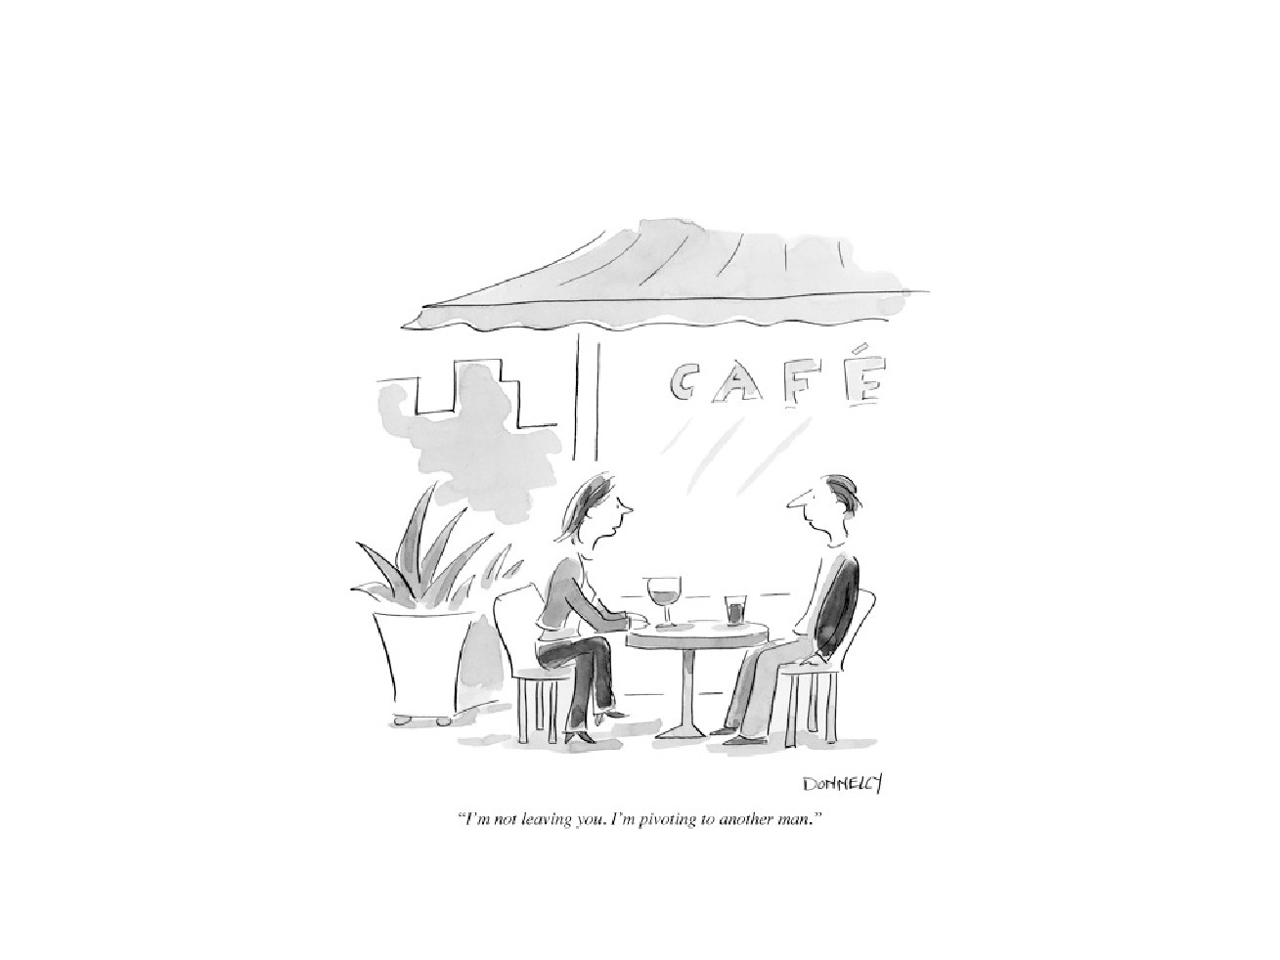
On Pivots
@dbinetti

Slide 23
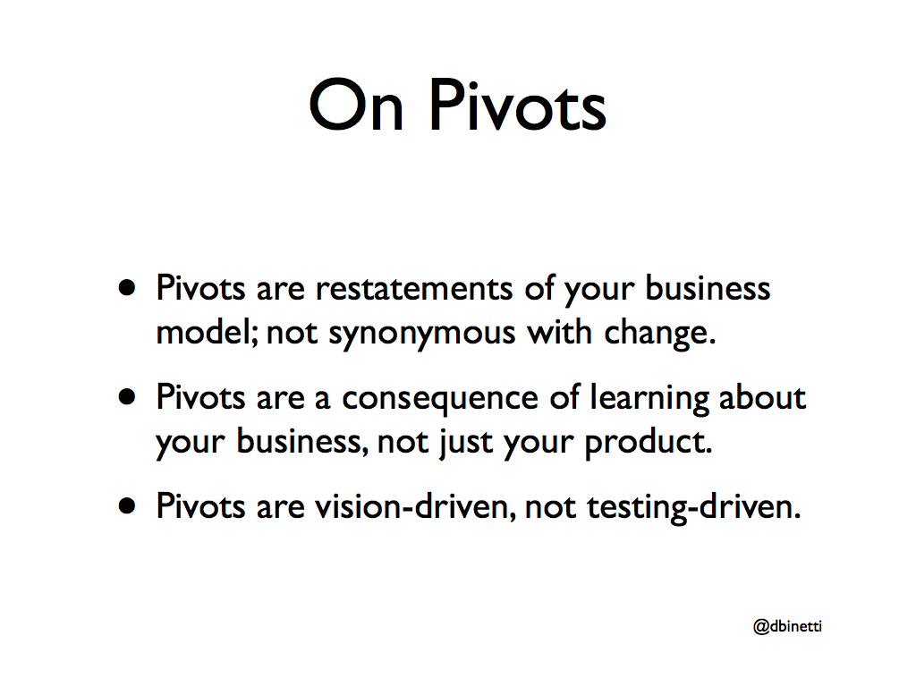
On Pivots
Pivots are restatements of your business model; not synonymous with change.
Pivots are a consequence of learning about your business, not just your product.
Pivots are vision-driven, not testing-driven.
@dbinetti

Slide 24
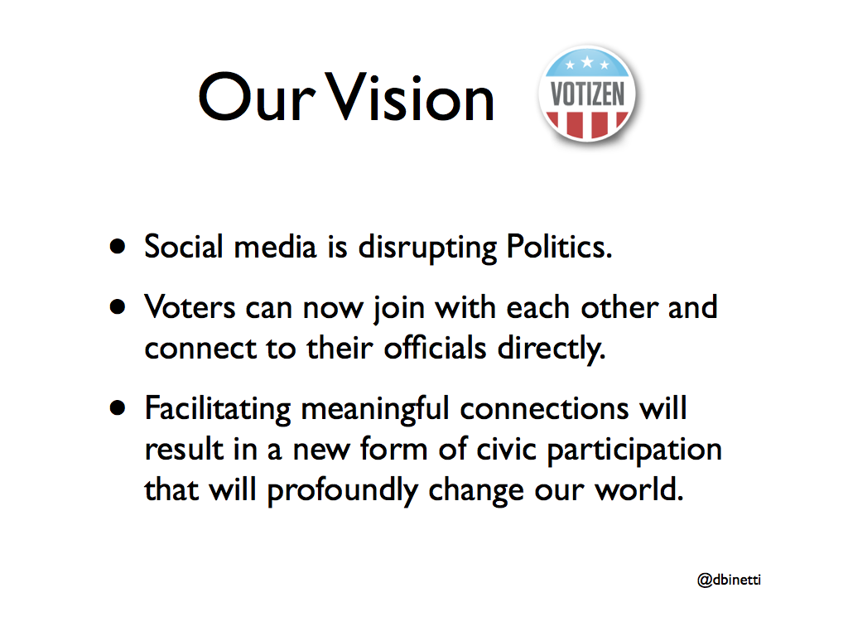


Our Vision
Social media is disrupting Politics.
Voters can now join with each other and connect to their officials directly.
Facilitating meaningful connections will result in a new form of civic participation that will profoundly change our world.
@dbinetti

Slide 25
The Framework
Formulate Iterate, Release &
Model
Measure
Pivot
@dbinetti

Slide 26
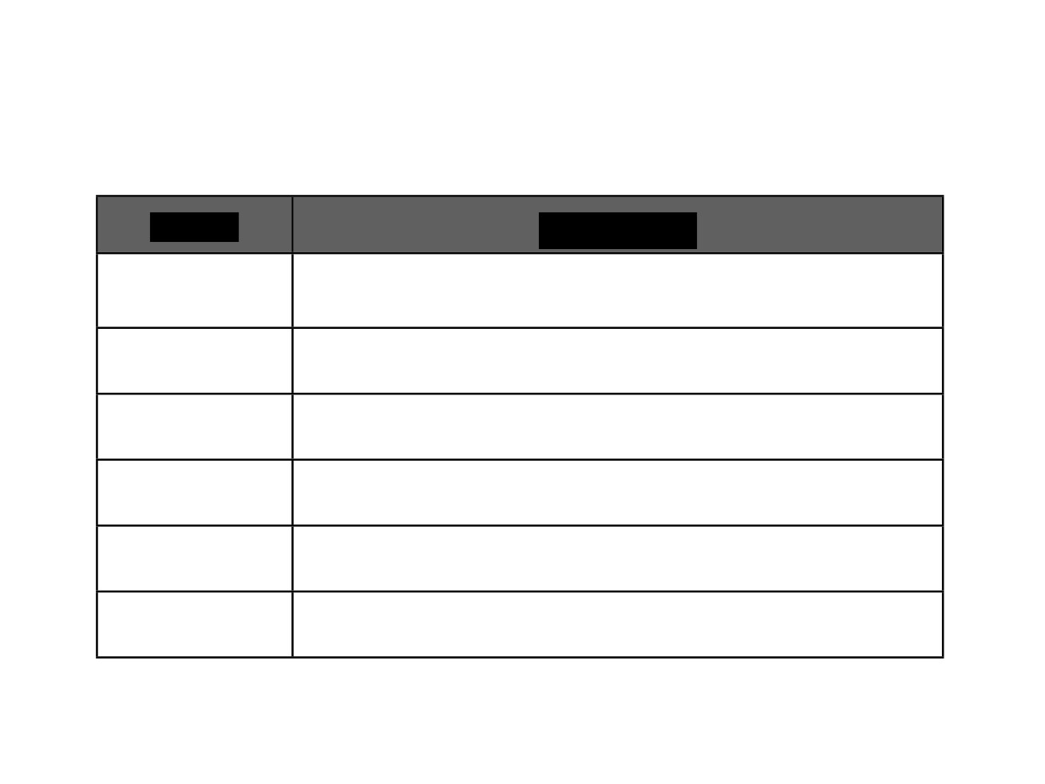
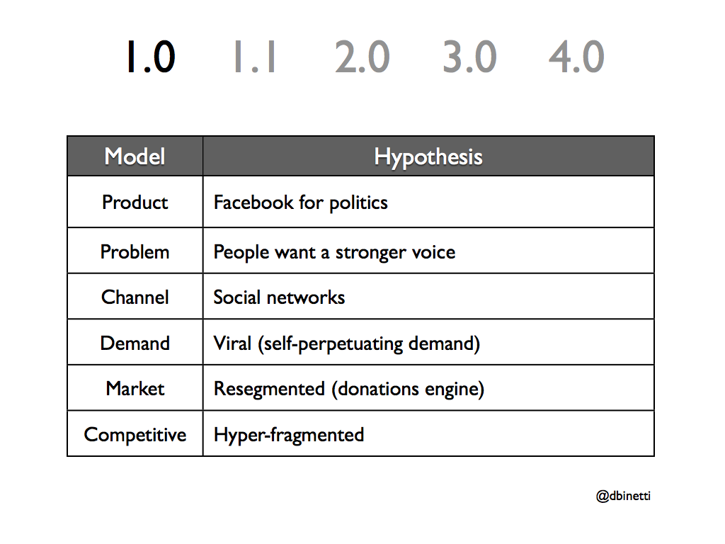
1.0
1.1
2.0
3.0
4.0
Model
Hypothesis
Model
Hypothesis
Product
Facebook for politics
Problem
People want a stronger voice
Channel
Social networks
Demand
Viral (self-perpetuating demand)
Market
Resegmented (donations engine)
Competitive
Hyper-fragmented
@dbinetti

Slide 27
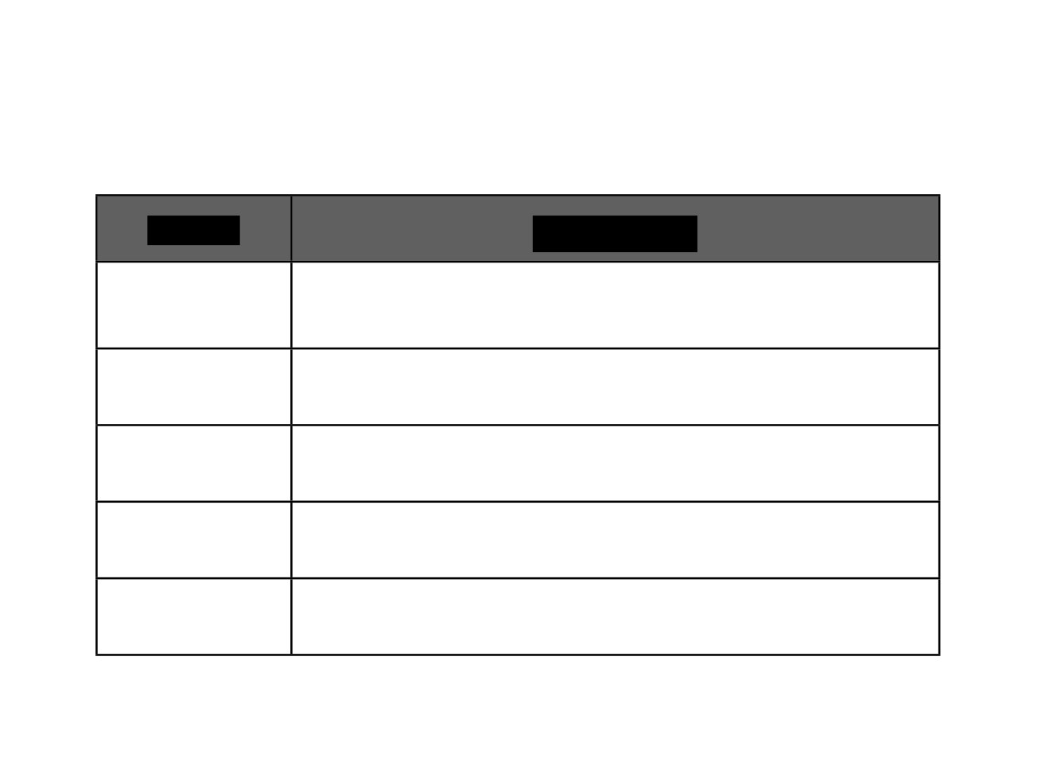
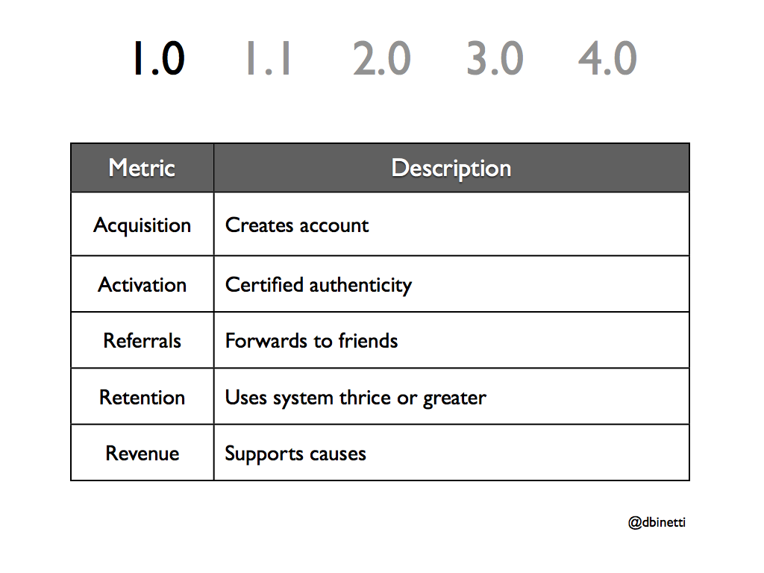
1.0
1.1
2.0
3.0
4.0
Metric
Description
Metric
Description
Acquisition
Creates account
Activation
Certified authenticity
Referrals
Forwards to friends
Retention
Uses system thrice or greater
Revenue
Supports causes
@dbinetti

Slide 28
The Framework
Formulate Iterate, Release &
Model
Measure
Pivot
@dbinetti

Slide 29
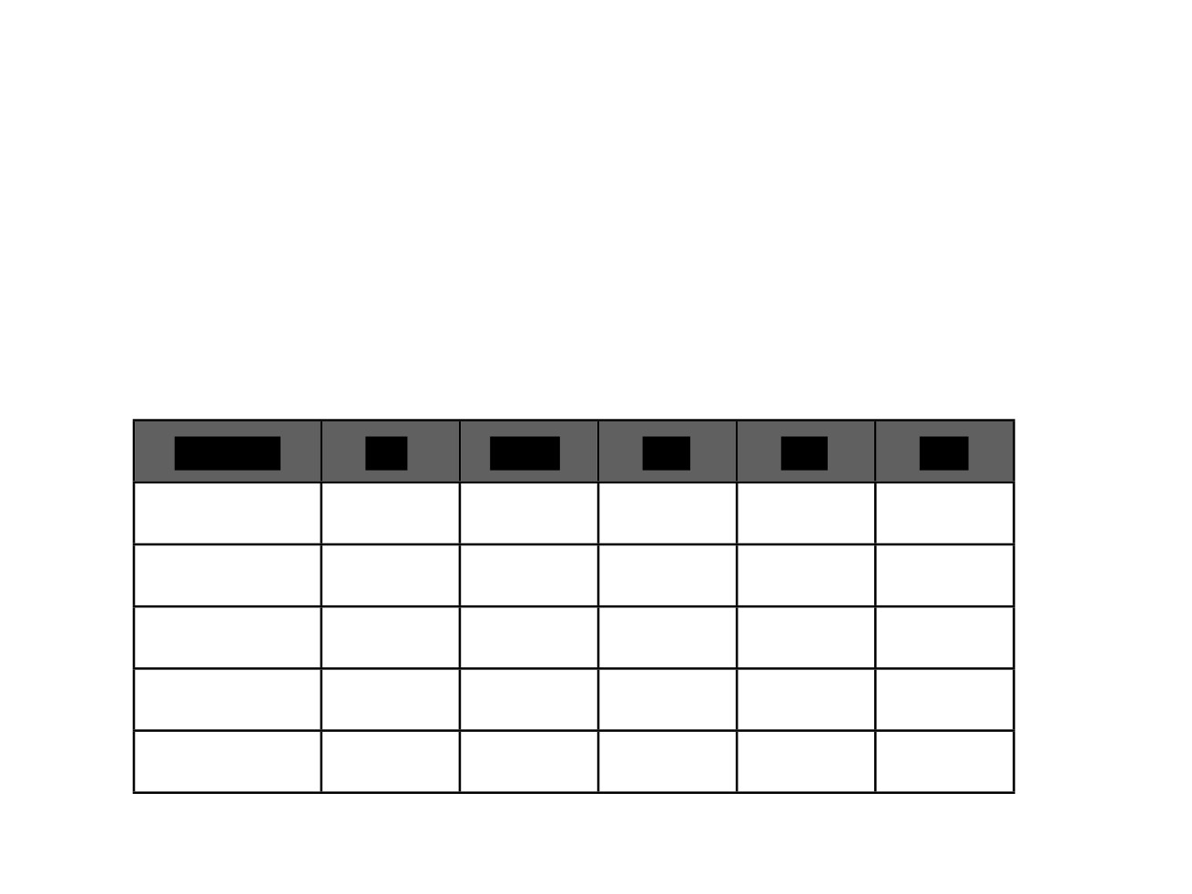
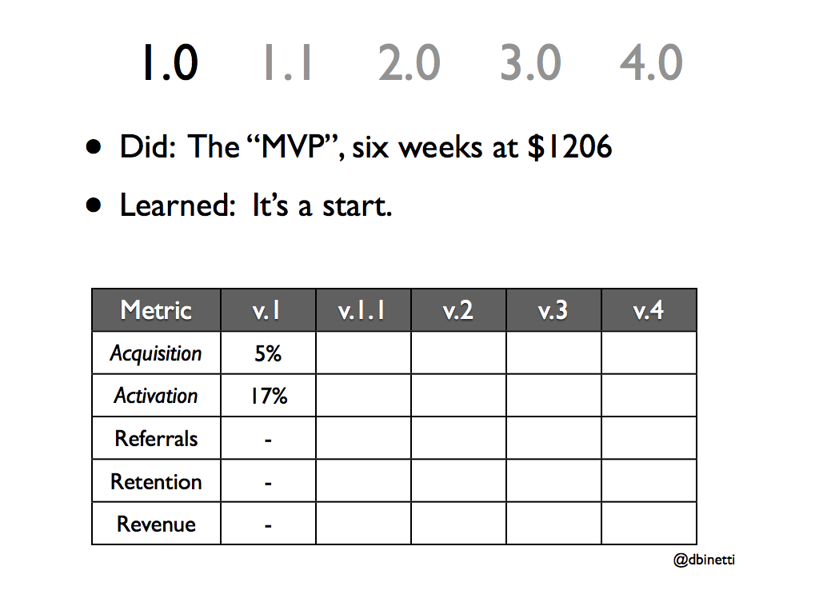
1.0
1.1
2.0
3.0
4.0
• Did: The “MVP”, six weeks at $1206
• Learned: It’s a start.
v.1
v.1.1
v.2
v.3
v.4
Metric
Metric
v.1
v.1.1
v.2
v.3
v.4
Acquisition
5%
Activation
17%
Referrals
-
Retention
-
Revenue
-
@dbinetti

Slide 30
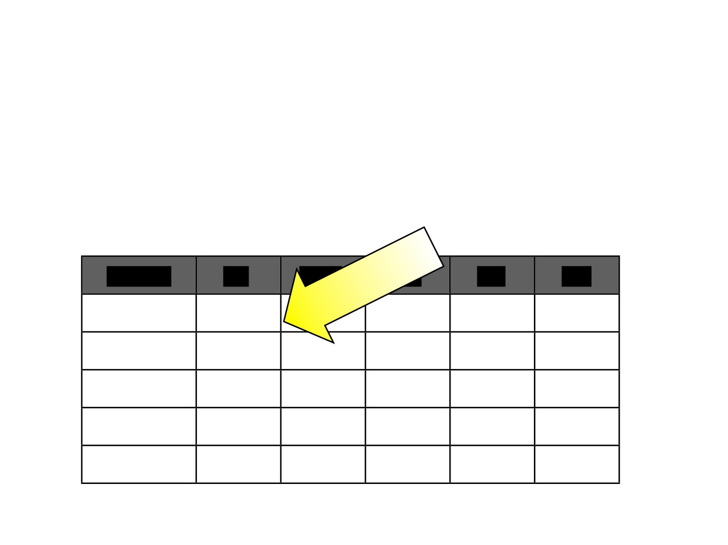
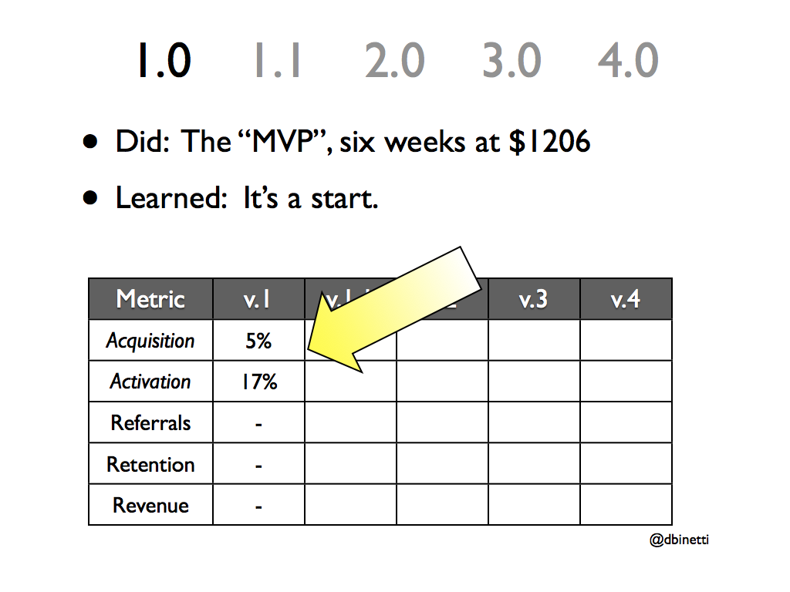
1.0
1.1
2.0
3.0
4.0
• Did: The “MVP”, six weeks at $1206
• Learned: It’s a start.
Metric
v.1
v.1.1
v.2
v.3
v.4
Acquisition
5%
Activation
17%
Referrals
-
Retention
-
Revenue
-
@dbinetti

Slide 31
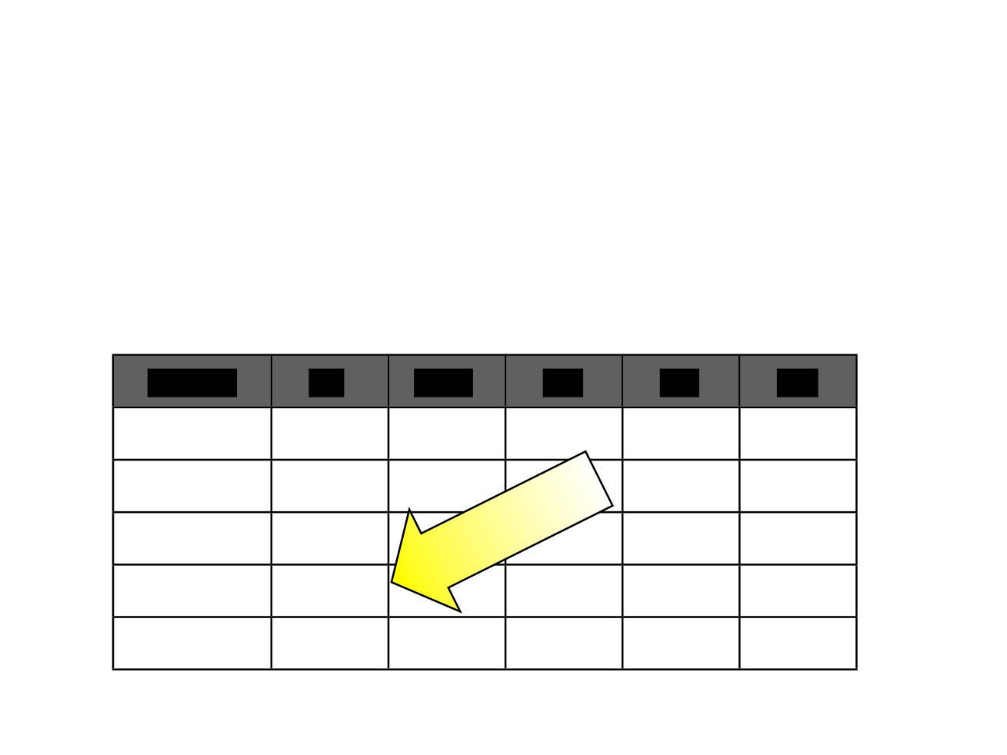
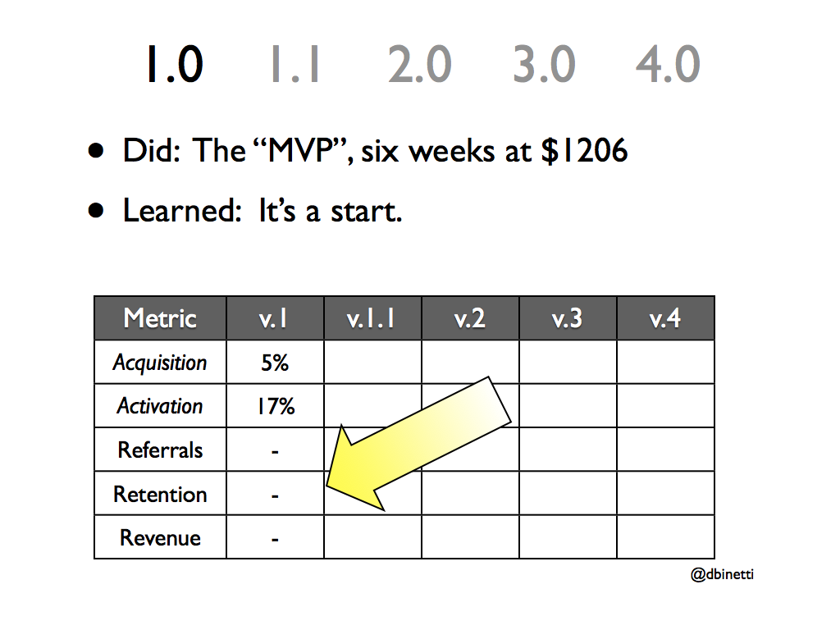
1.0
1.1
2.0
3.0
4.0
• Did: The “MVP”, six weeks at $1206
• Learned: It’s a start.
Metric
v.1
v.1.1
v.2
v.3
v.4
Acquisition
5%
Activation
17%
Referrals
-
Retention
-
Revenue
-
@dbinetti

Slide 32

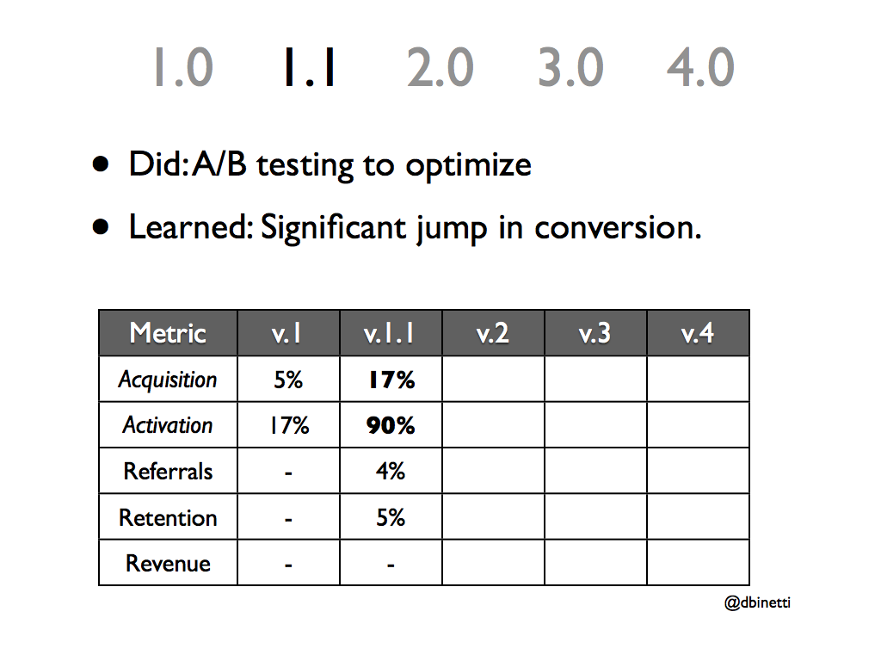
1.0
1.1
2.0
3.0
4.0
• Did: A/B testing to optimize
• Learned: Significant jump in conversion.
Metric
v.1
v.1.1
v.2
v.3
v.4
Acquisition
5%
17%
Activation
17%
90%
Referrals
-
4%
Retention
-
5%
Revenue
-
-
@dbinetti

Slide 33
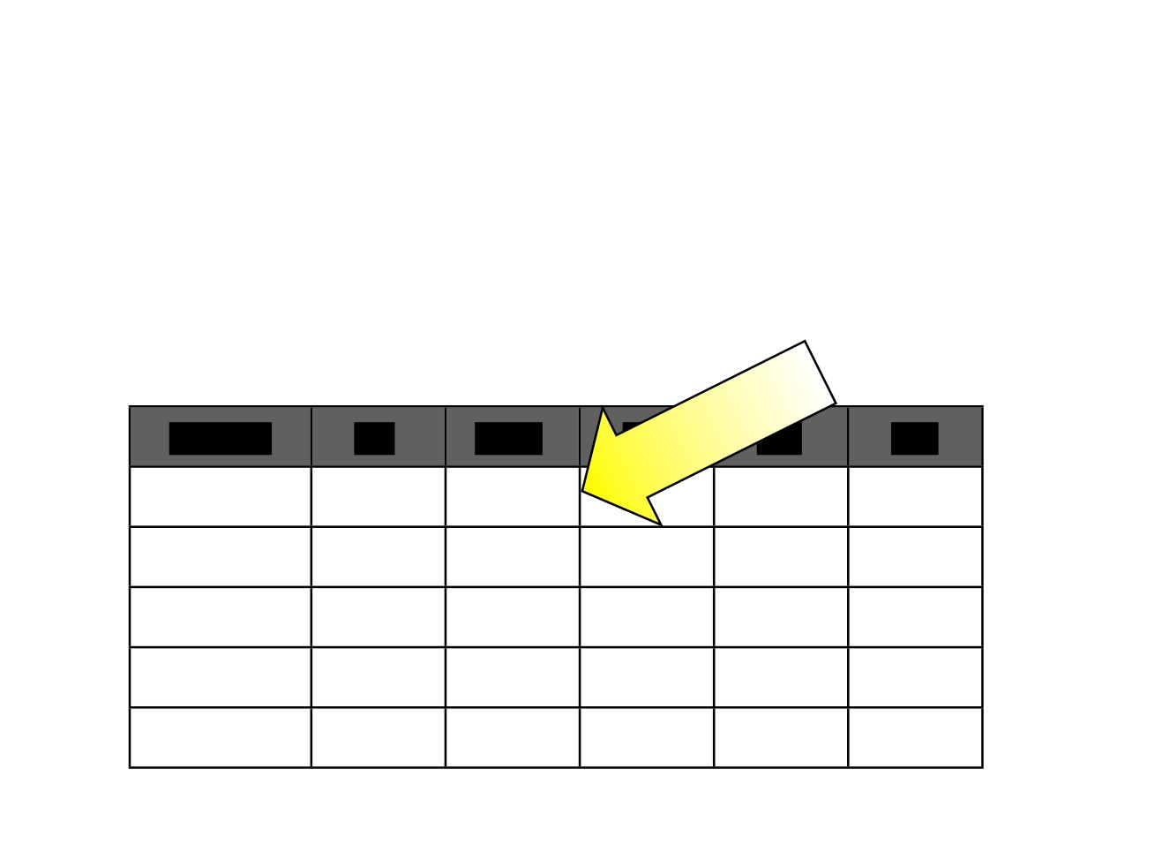
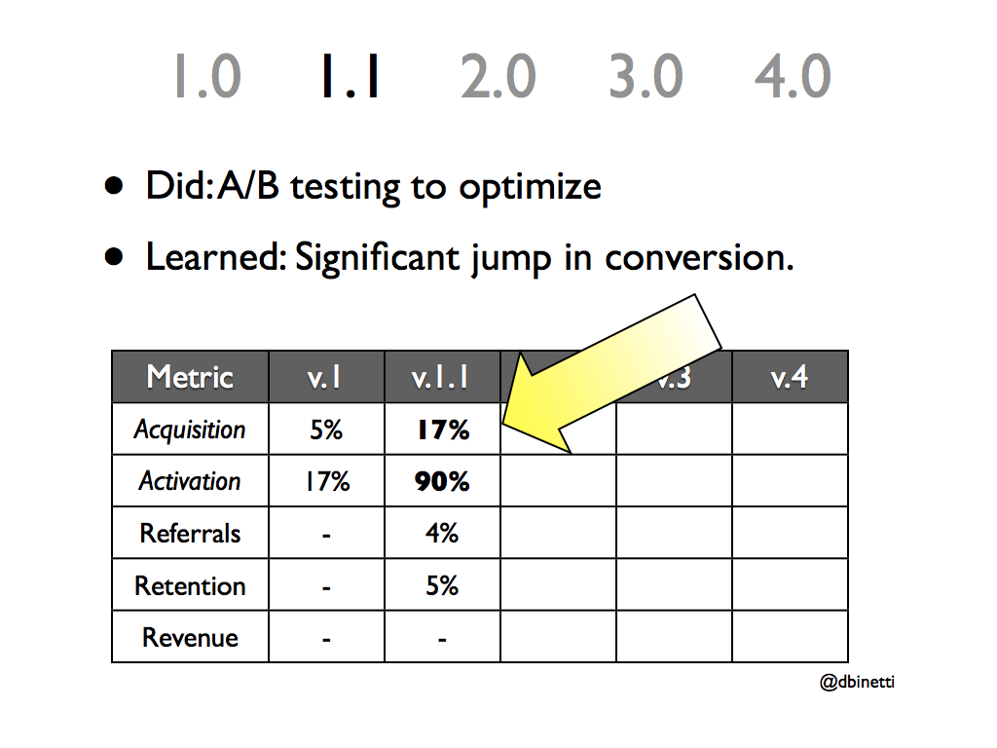
1.0
1.1
2.0
3.0
4.0
• Did: A/B testing to optimize
• Learned: Significant jump in conversion.
Metric
v.1
v.1.1
v.2
v.3
v.4
Acquisition
5%
17%
Activation
17%
90%
Referrals
-
4%
Retention
-
5%
Revenue
-
-
@dbinetti

Slide 34
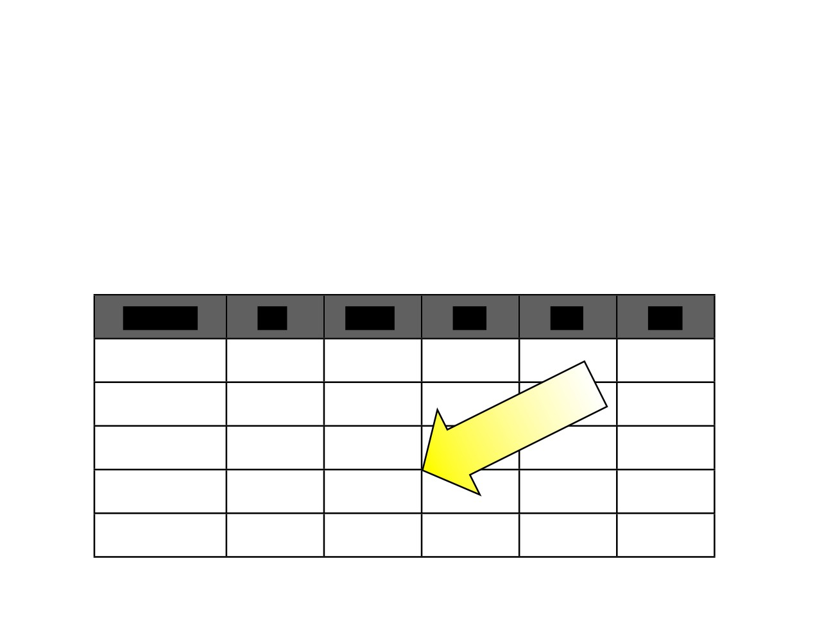
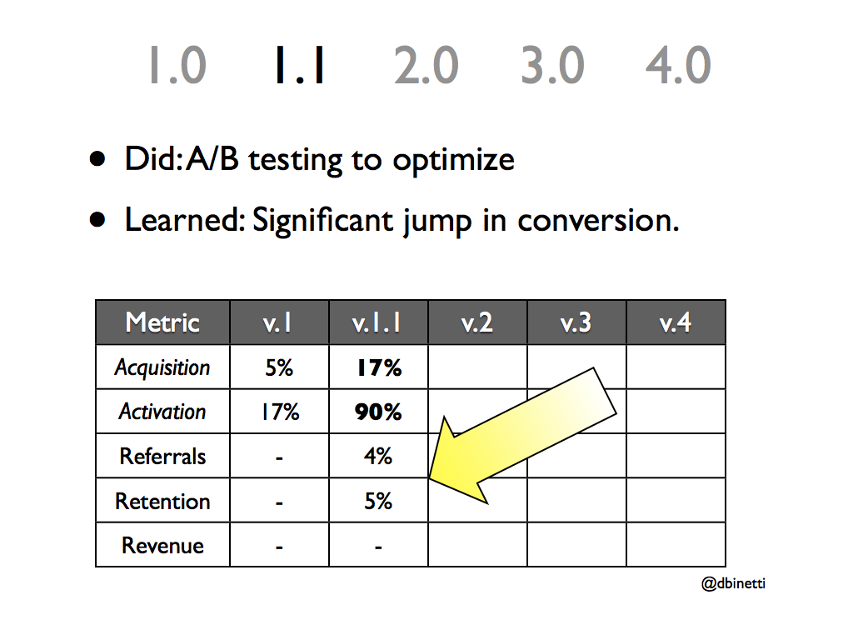
1.0
1.1
2.0
3.0
4.0
• Did: A/B testing to optimize
• Learned: Significant jump in conversion.
Metric
v.1
v.1.1
v.2
v.3
v.4
Acquisition
5%
17%
Activation
17%
90%
Referrals
-
4%
Retention
-
5%
Revenue
-
-
@dbinetti

Slide 35
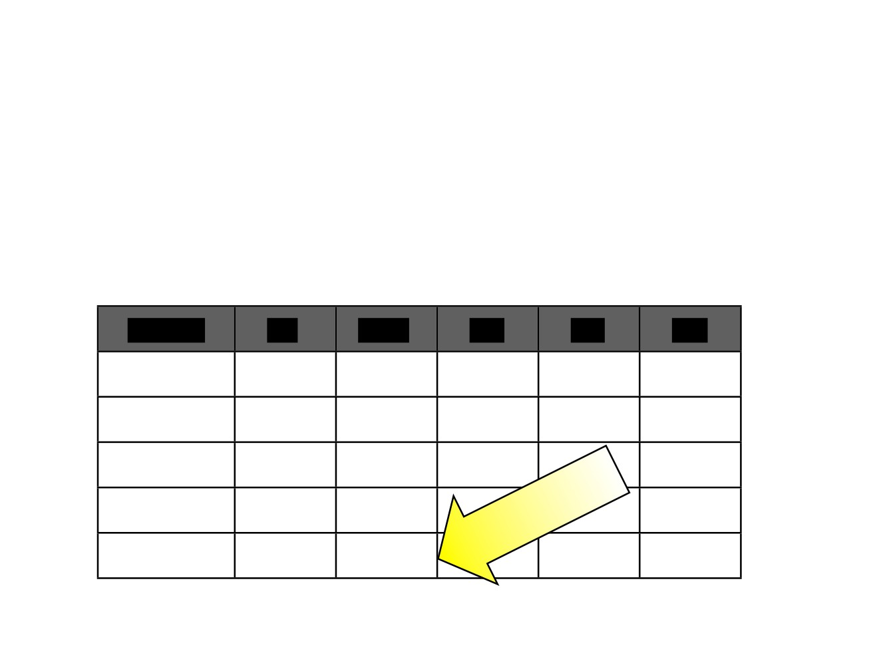
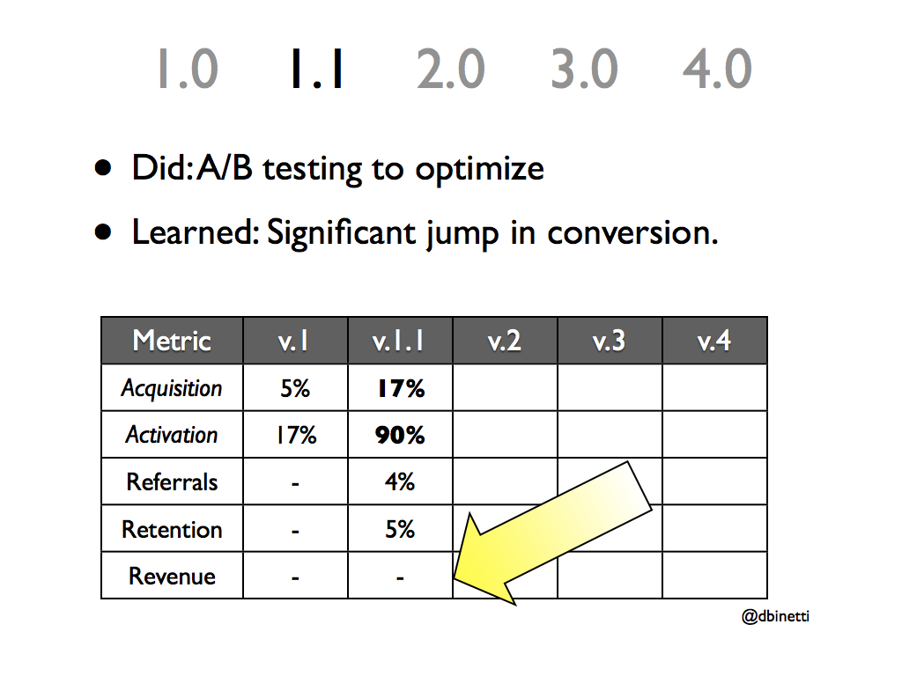
1.0
1.1
2.0
3.0
4.0
• Did: A/B testing to optimize
• Learned: Significant jump in conversion.
Metric
v.1
v.1.1
v.2
v.3
v.4
Acquisition
5%
17%
Activation
17%
90%
Referrals
-
4%
Retention
-
5%
Revenue
-
-
@dbinetti

Slide 36
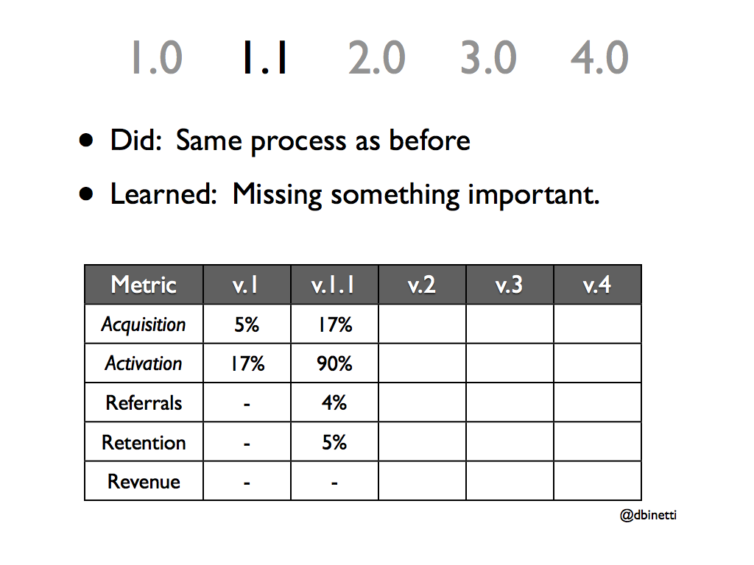
1.0
1.1
2.0
3.0
4.0
• Did: Same process as before
• Learned: Missing something important.
Metric
v.1
v.1.1
v.2
v.3
v.4
Acquisition
5%
17%
Activation
17%
90%
Referrals
-
4%
Retention
-
5%
Revenue
-
-
@dbinetti

Slide 37
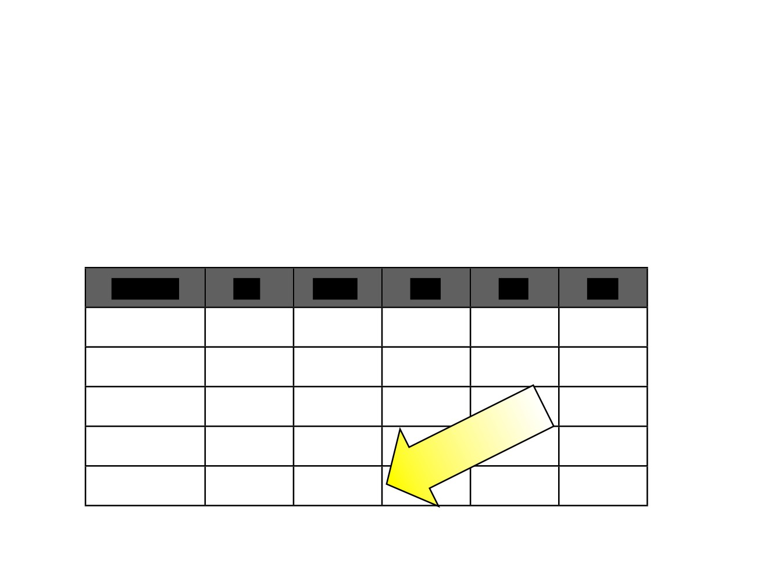
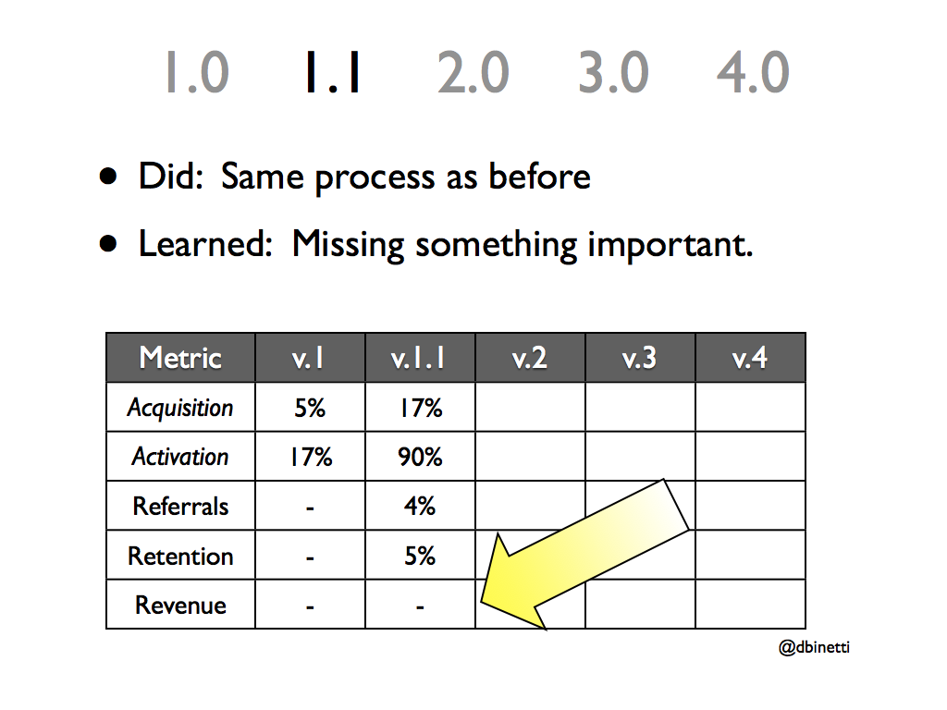
1.0
1.1
2.0
3.0
4.0
• Did: Same process as before
• Learned: Missing something important.
Metric
v.1
v.1.1
v.2
v.3
v.4
Acquisition
5%
17%
Activation
17%
90%
Referrals
-
4%
Retention
-
5%
Revenue
-
-
@dbinetti

Slide 38
The Framework
Formulate
Iterate, Release &
Model
Measure
Pivot
@dbinetti

Slide 39
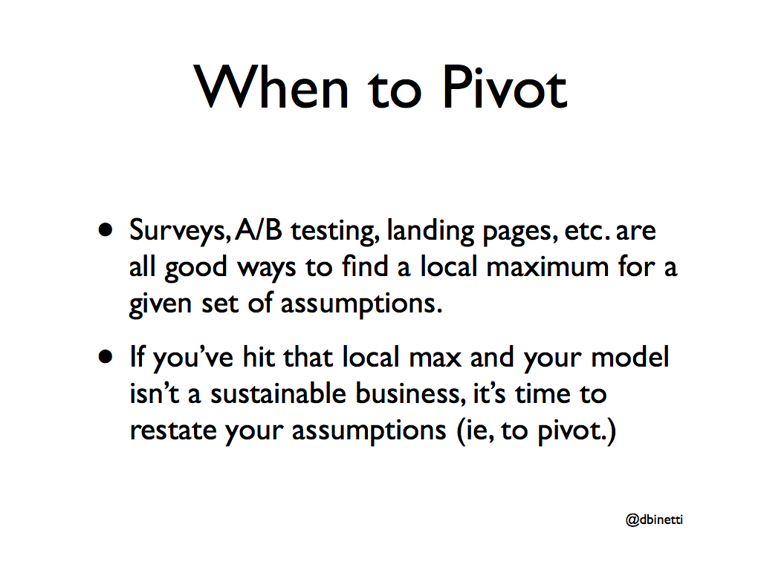
When to Pivot
• Surveys, A/B testing, landing pages, etc. are all good ways to find a local maximum for a
given set of assumptions.
• If you’ve hit that local max and your model isn’t a sustainable business, it’s time to
restate your assumptions (ie, to pivot.)
@dbinetti

Slide 40
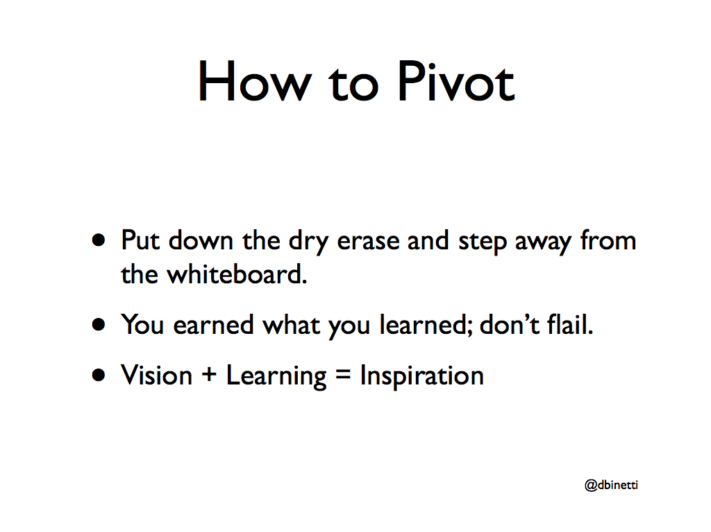
How to Pivot
• Put down the dry erase and step away from the whiteboard.
• You earned what you learned; don’t flail.
• Vision + Learning = Inspiration
@dbinetti

Slide 41
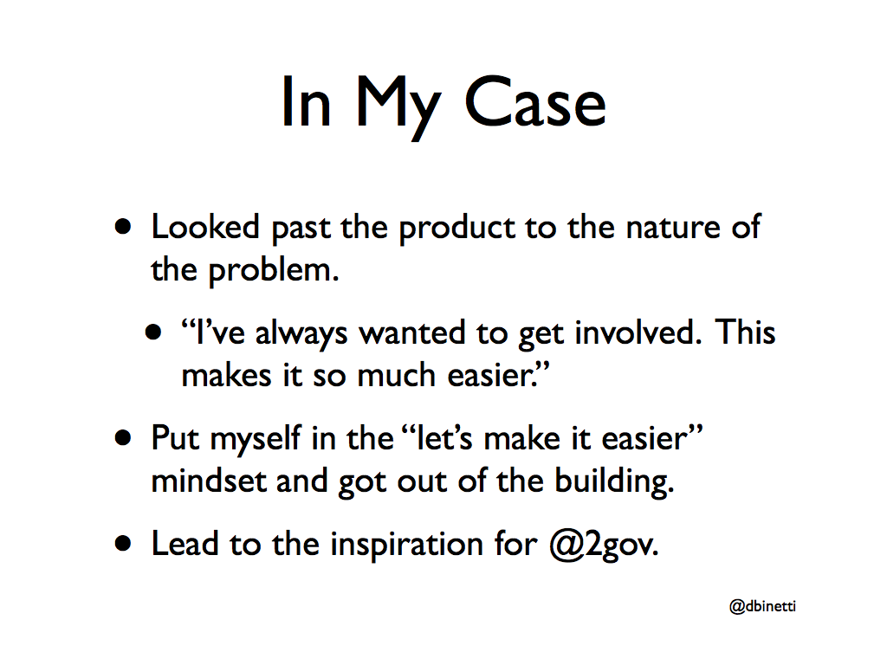
In My Case
• Looked past the product to the nature of the problem.
• “I’ve always wanted to get involved. This makes it so much easier.”
• Put myself in the “let’s make it easier” mindset and got out of the building.
• Lead to the inspiration for @2gov.
@dbinetti

Slide 42
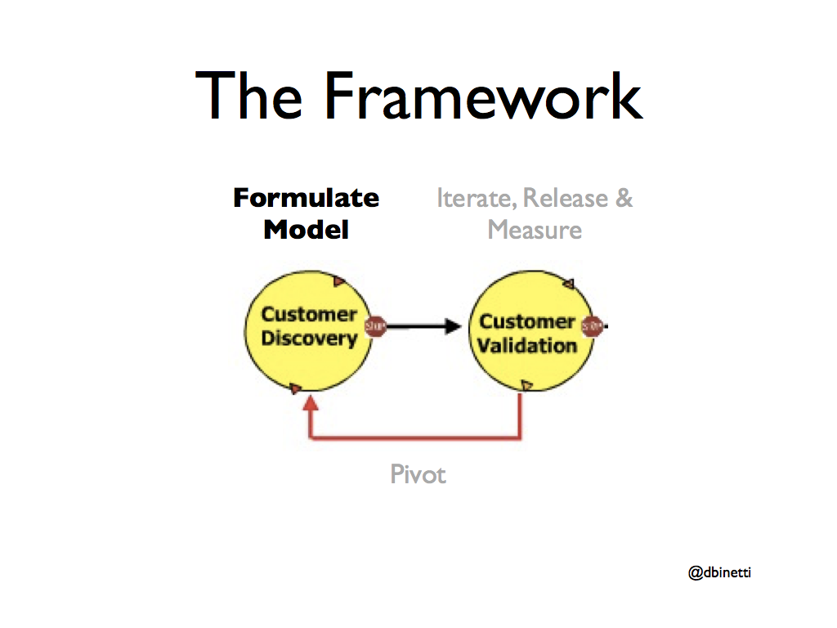
The Framework
Formulate Iterate, Release &
Model
Measure
Pivot
@dbinetti

Slide 43
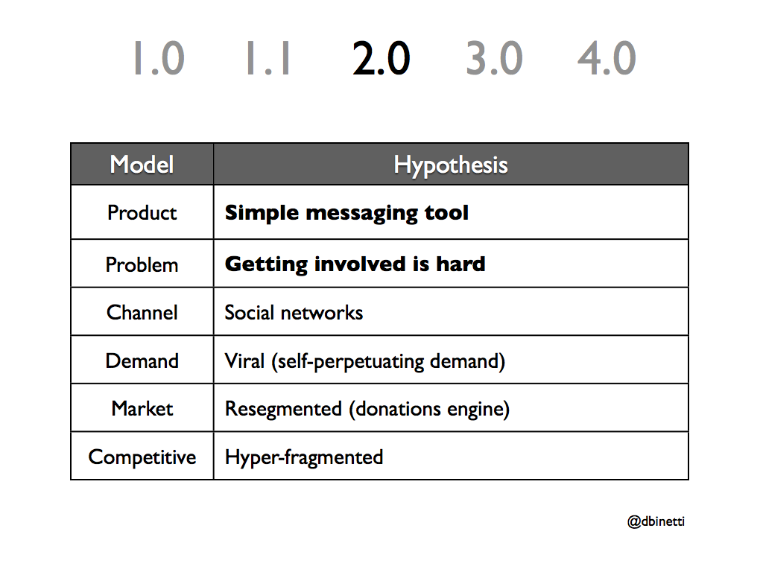
1.0
1.1
2.0
3.0
4.0
Model
Hypothesis
Model
Hypothesis
Product
Simple messaging tool
Problem
Getting involved is hard
Channel
Social networks
Demand
Viral (self-perpetuating demand)
Market
Resegmented (donations engine)
Competitive
Hyper-fragmented
@dbinetti

Slide 44
The Framework
Formulate Iterate, Release &
Model
Measure
Pivot
@dbinetti

Slide 45
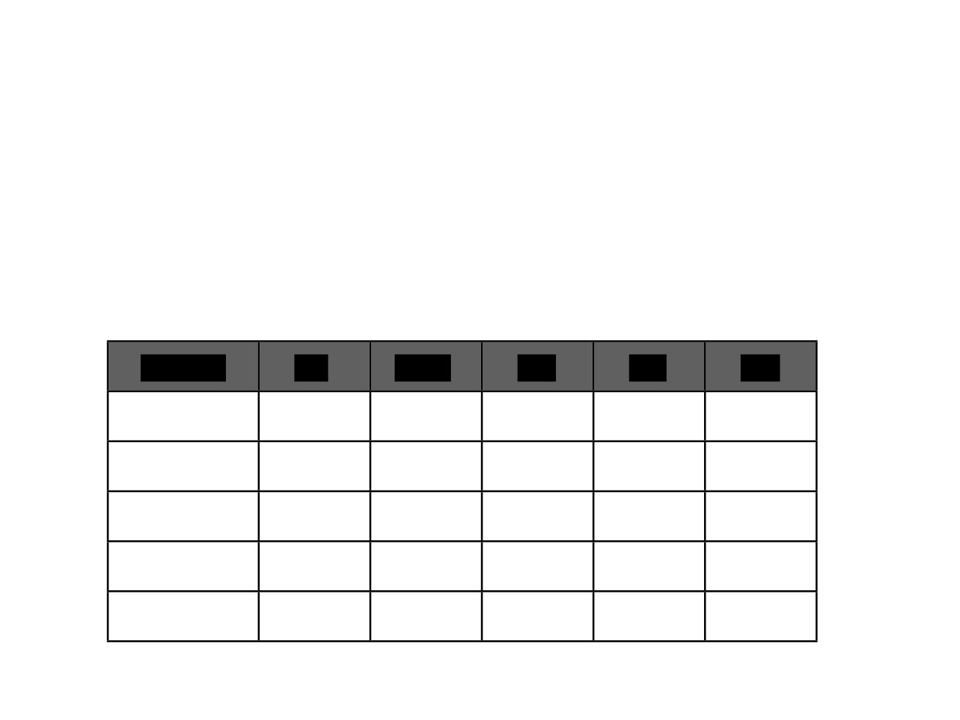
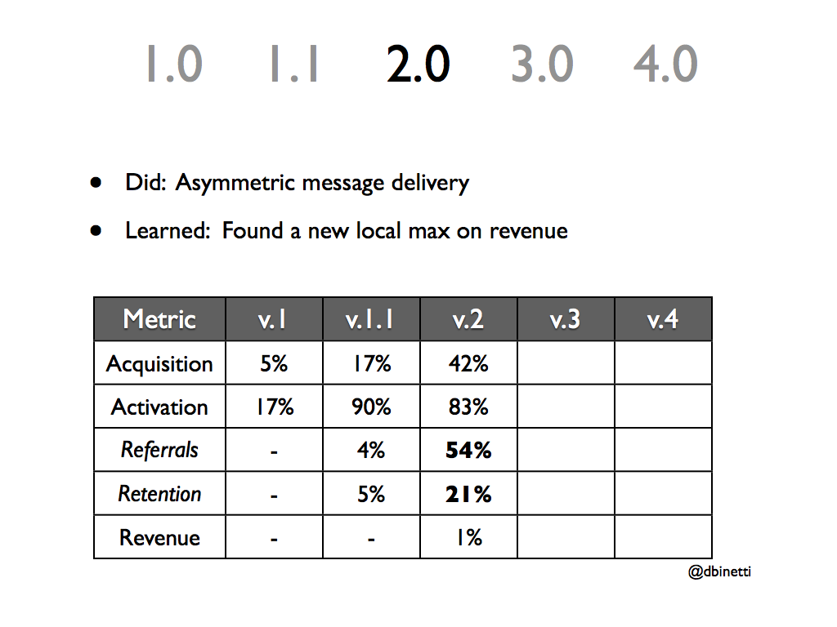
1.0
1.1
2.0
3.0
4.0
• Did: Asymmetric message delivery
• Learned: Found a new local max on revenue
Metric
v.1
v.1.1
v.2
v.3
v.4
Acquisition
5%
17%
42%
Activation
17%
90%
83%
Referrals
-
4%
54%
Retention
-
5%
21%
Revenue
-
-
1%
@dbinetti

Slide 46
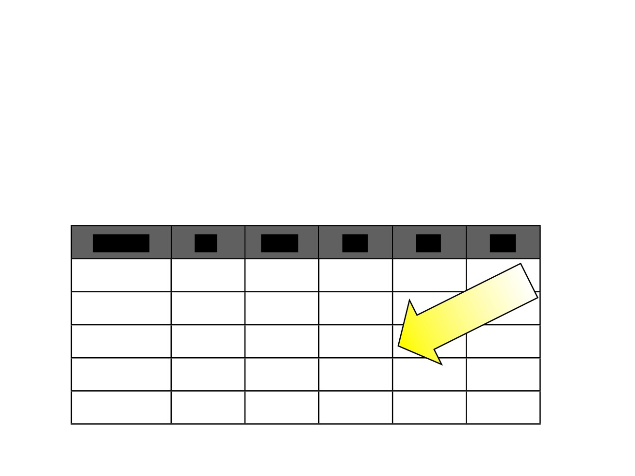
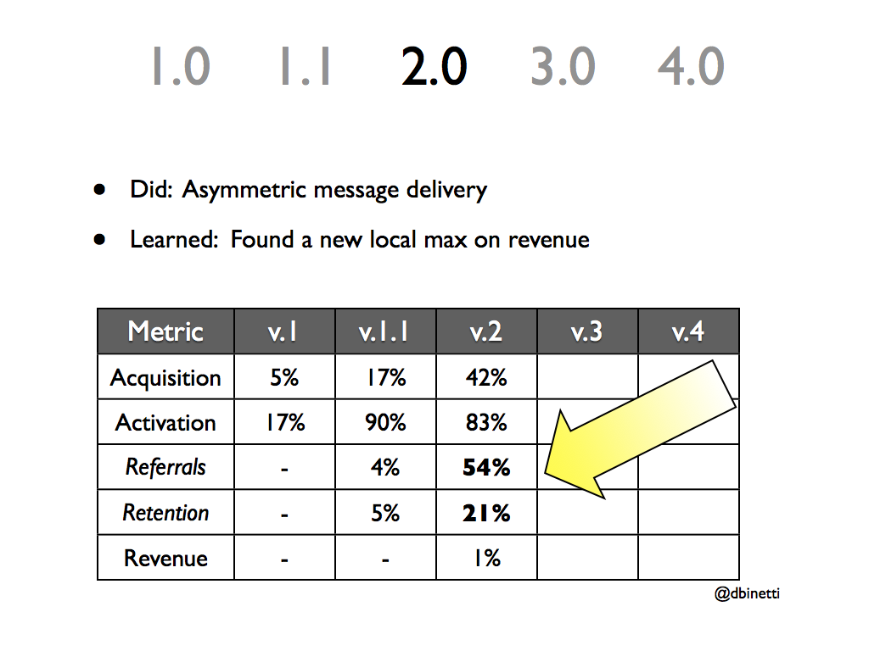
1.0
1.1
2.0
3.0
4.0
• Did: Asymmetric message delivery
• Learned: Found a new local max on revenue
Metric
v.1
v.1.1
v.2
v.3
v.4
Acquisition
5%
17%
42%
Activation
17%
90%
83%
Referrals
-
4%
54%
Retention
-
5%
21%
Revenue
-
-
1%
@dbinetti

Slide 47
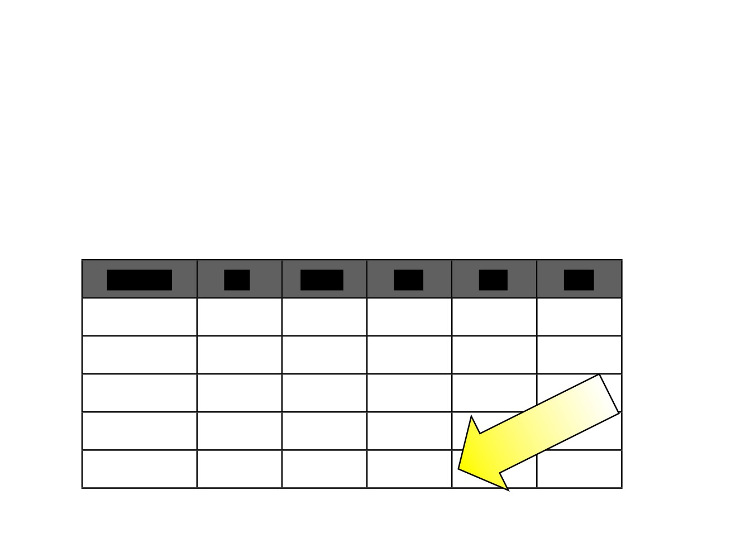
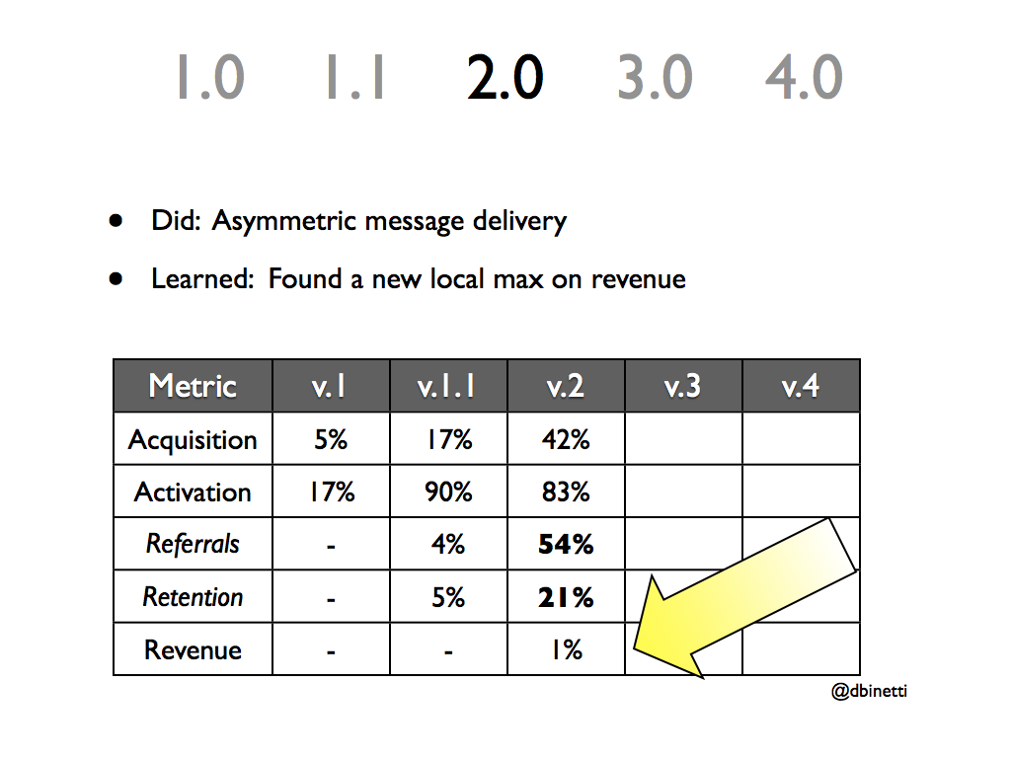
1.0
1.1
2.0
3.0
4.0
• Did: Asymmetric message delivery
• Learned: Found a new local max on revenue
Metric
v.1
v.1.1
v.2
v.3
v.4
Acquisition
5%
17%
42%
Activation
17%
90%
83%
Referrals
-
4%
54%
Retention
-
5%
21%
Revenue
-
-
1%
@dbinetti

Slide 48
The Framework
Formulate
Iterate, Release &
Model
Measure
Pivot
@dbinetti

Slide 49
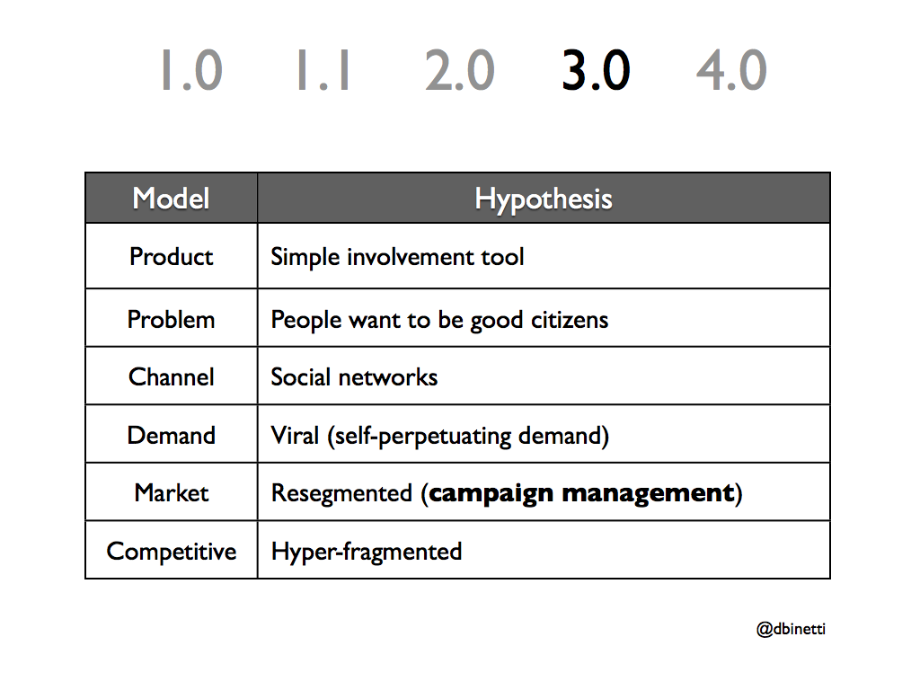
1.0
1.1
2.0
3.0
4.0
Model
Hypothesis
Model
Hypothesis
Product
Simple involvement tool
Problem
People want to be good citizens
Channel
Social networks
Demand
Viral (self-perpetuating demand)
Market
Resegmented (campaign management)
Competitive
Hyper-fragmented
@dbinetti

Slide 50
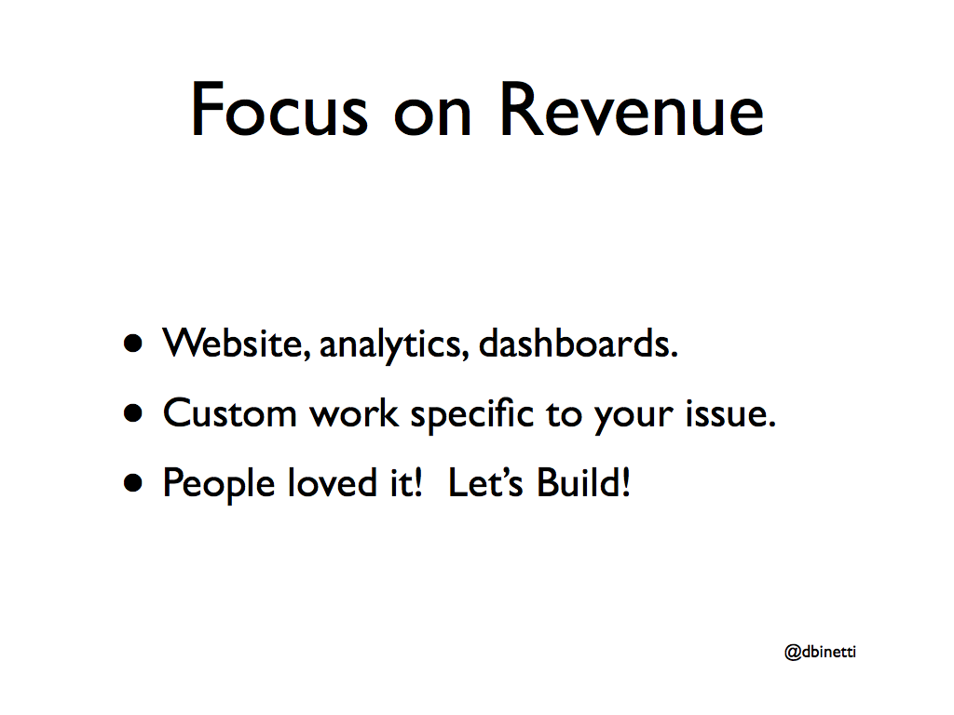
Focus on Revenue
•Website, analytics, dashboards.
•Custom work specific to your issue.
•People loved it! Let’s Build!
@dbinetti

Slide 51

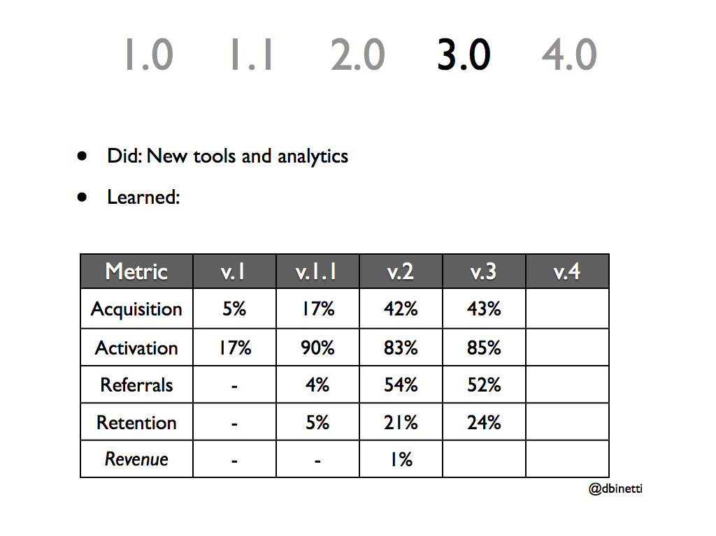
1.0
1.1
2.0
3.0
4.0
• Did: New tools and analytics
• Learned:
Metric
v.1
v.1.1
v.2
v.3
v.4
Acquisition
5%
17%
42%
43%
Activation
17%
90%
83%
85%
Referrals
-
4%
54%
52%
Retention
-
5%
21%
24%
Revenue
-
-
1%
@dbinetti

Slide 52

1.0
1.1
2.0
3.0
4.0
• Did: New tools and analytics
• Learned:
Metric
v.1
v.1.1
v.2
v.3
v.4
Acquisition
5%
17%
42%
43%
Activation
17%
90%
83%
85%
Referrals
-
4%
54%
52%
Retention
-
5%
21%
24%
Revenue
-
-
1%
0%
@dbinetti

Slide 53
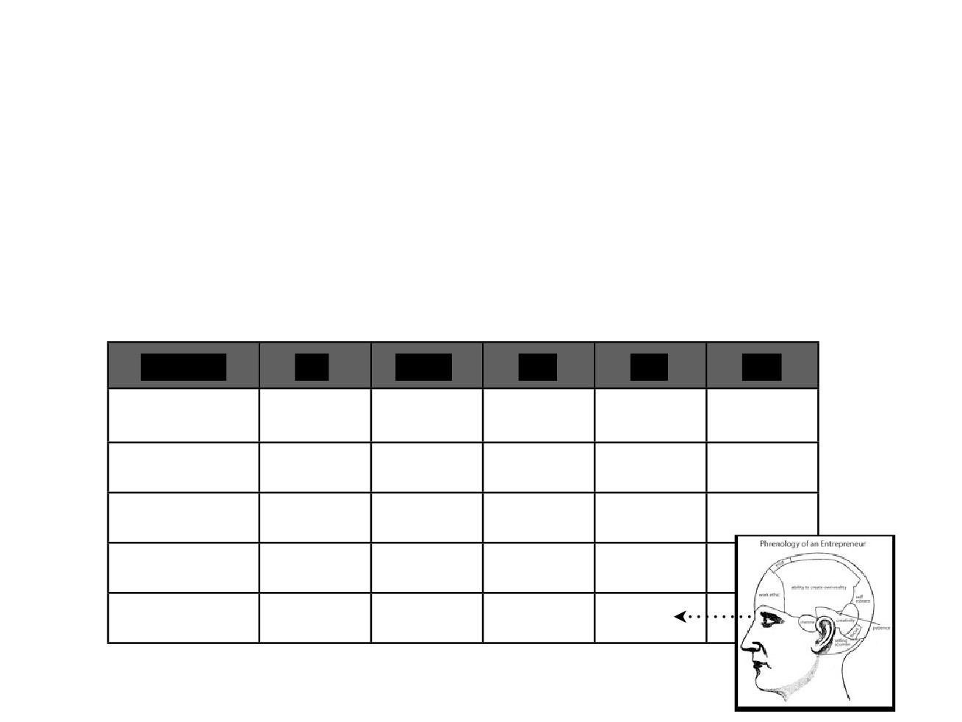
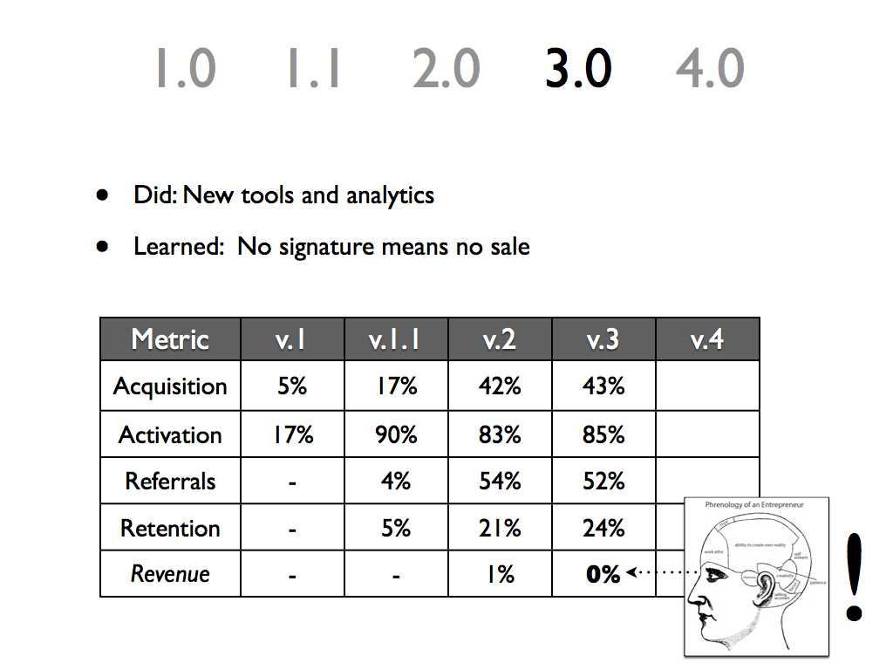
1.0
1.1
2.0
3.0
4.0
• Did: New tools and analytics
• Learned: No signature means no sale
Metric
v.1
v.1.1
v.2
v.3
v.4
Acquisition
5%
17%
42%
43%
Activation
17%
90%
83%
85%
Referrals
-
4%
54%
52%
Retention
-
5%
21%
24%
!
Revenue -
- 1% 0%

Slide 54
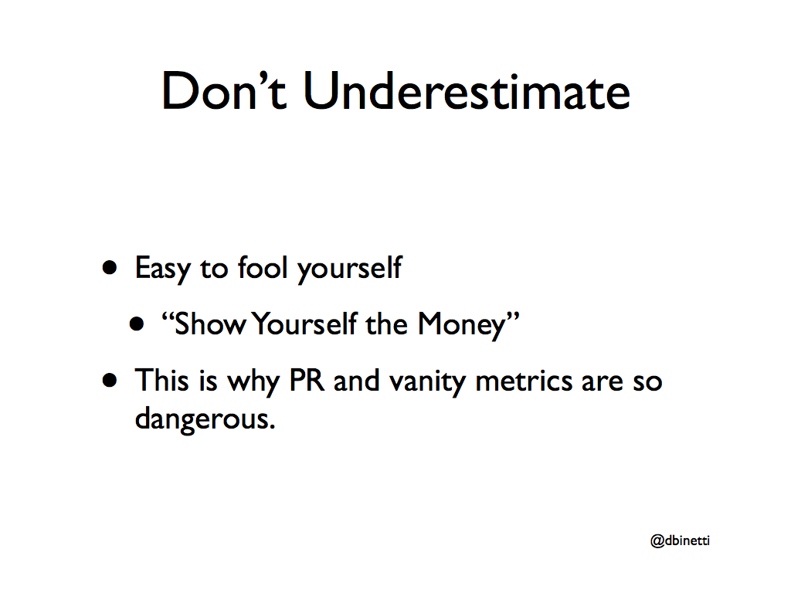
Don’t Underestimate
• Easy to fool yourself
• “Show Yourself the Money”
• This is why PR and vanity metrics are so dangerous.
@dbinetti

Slide 55
The Framework
Formulate
Iterate, Release &
Model
Measure
Pivot
@dbinetti

Slide 56

Learning
• Poor Sales Cycle (contract, cost, channel)
• “I’m just not sure about this Twitter thing.”
• Make the engagement easy to try and show ROI out of the gate.
@dbinetti

Slide 57

1.0
1.1
2.0
3.0
4.0
Model
Hypothesis
Model
Hypothesis
Product
Simple involvement tool
Problem
People want to be good citizens
Channel
Social networks
Demand
Viral (self-perpetuating demand)
Market
Resegmented (look like AdWords)
Competitive
Hyper-fragmented
@dbinetti

Slide 58

Ad Words for Activism
• Special Delivery on a per-message basis
• Only pay for value
• Initial sale: $200 first day.
@dbinetti

Slide 59


1.0
1.1
2.0
3.0
4.0
• Total investment at this point: ~$120K and 18 months.
• Model has promise; raise some funds
Metric
v.1
v.1.1
v.2
v.3
v.4
Acquisition
5%
17%
42%
43%
51%
Activation
17%
90%
83%
85%
92%
Referrals
-
4%
54%
52%
64%
Retention
-
5%
21%
24%
28%
Revenue
-
-
1%
0%
11%
@dbinetti

Slide 60


1.0
1.1
2.0
3.0
4.0
• Total investment at this point: ~$120K and 18 months.
• Model has promise; raise some funds
Metric
v.1
v.1.1
v.2
v.3
v.4
Acquisition
5%
17%
42%
43%
51%
Activation
17%
90%
83%
85%
92%
Referrals
-
4%
54%
52%
64%
Retention
-
5%
21%
24%
28%
Revenue
-
-
1%
0%
11%
@dbinetti

Slide 61

Important Notes
• Iteration loops got tighter.
• Each validation justified a higher level of investment/engagement.
• 1K - 10K - 100K - 1000K
• Seek funding when you think you have more technical risk than market risk.
@dbinetti

Slide 62

Summary
• Set Model so you know what your measuring and when you’re done.
• Use Metrics to find local maxima, not to find a business.
• Pivots are vision-driven.
@dbinetti

Slide 63

Since Then...

Slide 64

Brigade

Slide 65
Pivots require courage
Vanity metrics lead to false conclusions
Pivots require a clear hypothesis
Acknowledging failure is hard
Notes:
“Launch and see what happens”

Slide 66

Discussion

Slide 67
How to pivot?
Realize when your plan isn’t working.
Come up with a list of possible reasons why it’s not working.
Gain a fresh perspective on your long-term goals and vision for the business.
Revise those goals and visions as necessary.
Come up with a list of ideas that will help you to accomplish those goals.
Develop a clearly defined plan.
Define the numbers or signs that will gauge the success of your new plan.
Forget the previous plan.
Explain the plan to the team.
Embrace the new plan.
Watch the metrics.
Rinse and repeat.
Source https://www.huffingtonpost.com/neil-patel/how-to-pivot-a-12step-gui_b_9560326.html

Slide 69
Pivoting
Don’t throw good money after bad
Embracing flexability
Definition
Examples:
Types of pivots

Slide 70
Votizen

